Slide 1
2021 College Goal Wisconsin
2021-22 School Year
Notes:
Welcome parents and students
Point out volunteers

Slide 2
Agenda
Presentation
Question and answer
FAFSA completion (computer labs)
Complete evaluation
Scholarship drawing
Notes:
– Read through Agenda
Cover any site specifics here
Where to find restrooms
Computer labs
Who is available for assistance
Remind that they must complete the evaluation to enter the scholarship drawing. The drawing will be held after all statewide events have completed. They will be notified by US Mail if they are one of the selected recipients.

Slide 4
FAFSA Completion
The FAFSA opens for completion on October 1
You will use 2019 taxes to complete the FAFSA
Notes:
Remind families that the FAFSA will now open for completion each October 1st and they will use the previous year’s taxes.

Slide 5
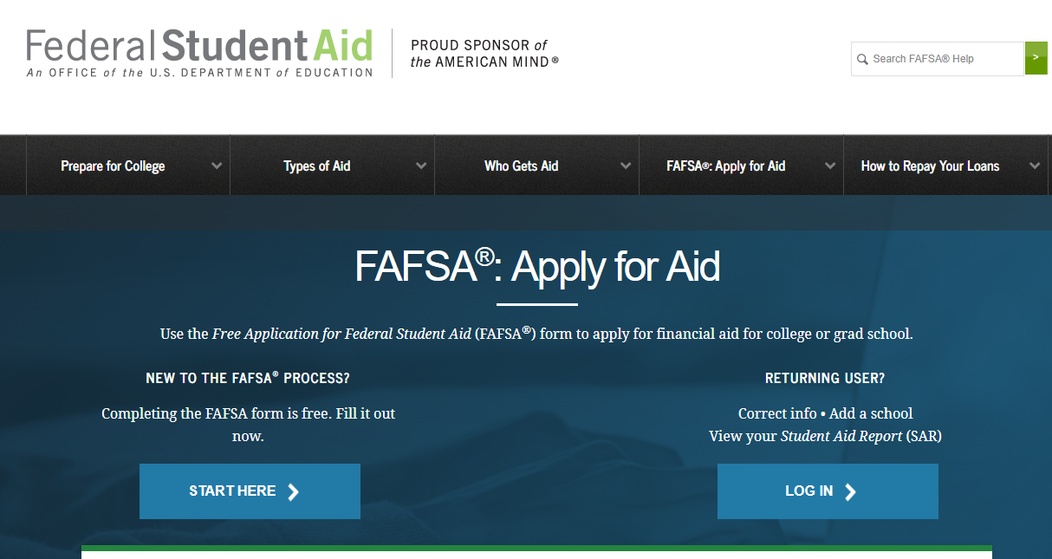
FREE APPLICATION FOR FEDERAL STUDENT AID (FAFSA) FREE APPLICATION FOR FEDERAL STUDENT AID (fafsa)
Never pay a fee to file the FAFSA
Go directly to https://studentaid.ed.gov/sa/fafsa
Redesigned Mobile Friendly FAFSA Site
myStudentAid Mobile App now available
Notes:
Completing the FAFSA is FREE –Be sure to complete the 2020-21 FAFSA. We will go over a list of the items needed to complete your FAFSA later in this presentation. A list is also available on the CGWI website or on the flyer. When you go into the computer lab after the presentation, volunteers will be there to assist you with any questions that you have about the FAFSA and signing your FAFSA with your fsa id. The student will need to secure an fsa id as well as a parent

Slide 6
What does College Cost?
Tuition
+ Room and Board
+ Transportation
+ Books & Supplies
+ Miscellaneous Living Expenses
= Cost of Attendance (COA)
Notes:
The Cost of Attendance includes items such as tuition, room and board (living on campus, off campus or with your parents), books, transportation, and miscellaneous expenses). For example a private school, UW System school, and a technical college will all have varying costs of attendance.

Slide 7
How is Financial Aid Determined?
Cost of Attendance
- Expected Family Contribution ___________________________
= Need
Notes:
By filling out the FREE application for Federal Student Aid today (FAFSA) you will be applying for federal and state grants, loans and institutional aid. This is your gateway to financial aid. The EFC which does not change is deducted from the Cost of Attendance which varies from school to school. The difference is the amount of need you have for financial aid.

Slide 8
What is the Expected Family Contribution (EFC)?
Established by Congress
The EFC is the amount a family can reasonably be expected to contribute, but not what the family will actually pay to the college
An index number used to calculate eligibility for aid
Stays the same regardless of college/university
Notes:
Your aid will be based on your family’s financial need which is determined by using the information you provide on the FAFSA to calculate your expected family contribution (EFC). This is not what you will have to pay out of pocket instead it is a measure of your ability based on several factors to assist in paying for college. The EFC is subtracted from your COA at the school you are planning to attend to determine your financial need. This need is what is filled by financial aid which includes grants (free money), college work study, scholarships, and low interest rate student loans.

Slide 9
types of financial aid
By completing the FAFSA you will be applying for:
federal grants, loans, and work study
state grants
FAFSA information may also be used for:
institutional aid
scholarships
Notes:
Some institutional and state aid will require additional application materials. A CGWI volunteer can help you with the deadlines of the Wisconsin college/universities with their FAFSA deadline dates and if they require an additional institutional financial aid form. Check with the postsecondary schools you are considering attending to access any additional information that they made need. Make sure to watch college deadline dates and respond promptly to any request for additional information. It is important check with the school you are attending to ensure you have completed all requirements for all aid available.

Slide 10
Items needed to complete the FAFSA
Social Security Number. Be sure that it is correct! Parent(s) and student.
Records of income. Such as income earned from work and business, child support paid or received, and any other untaxed income.
Tax returns. W-2 Forms and the 2019 Federal Income Tax Return IRS 1040.
Estimated income. If you need to use estimated taxes, use your best estimate and return later to download the information from your 2019 Federal Tax Return.
Information about assets will be explained in the next few slides.
Driver’s license number if the student has one.
Alien Registration Number if not a U.S. citizen.
Date of birth for the parent(s) and student.
Date of parent’s marriage or divorce if requested.
Notes:
Here is a list of all the items that the student and parent (if a dependent student) will need to complete the FAFSA. If you have these items when you sit down at the computer, you should be able to complete the FAFSA and submit it. If not, you can always save the FAFSA and return to it at a later time.

Slide 11
Before you begin… Determine who is a parent?
Parents are….
Two biological or adoptive parents REGARDLESS of marital status or gender if those parents live together
Divorced or separated parents
Stepparents
Who are not considered parents?
Legal guardians
Grandparents
Other relatives the student lives with
Foster parents
Notes:
– Some specific information you may need to know before you begin completing the parent:
Who is a parent?
Two biological or adoptive parents REGARDLESS of marital status OR gender, if those parents live together
Divorced or separated parents
Stepparent
Widowed parent
Do not provide income information on:
Legal guardians
Grandparents
Other relatives the student might live with
Foster parents

Slide 12
Determine the value of your assets
Assets are:
Trust funds
Certificates of deposits
Mutual funds, stocks, bonds
529 College Plans
UGMA/UTMA accounts
Coverdell Savings Account
Second home/cottage
Rental Property
Land not associated with farming
Notes:
Be sure to use net worth which means the value minus any debt.

Slide 13
Do not include these items as assets:
Assets are NOT. . .
Net worth of the home where you are living
Qualified pensions/ retirement savings/ annuities
Life insurance policies
Value of car, boat, stereo
Family farm
Business (if less than 100 employees)
Non educational IRAs
Keogh Plans
Land your residence is locate
Notes:
These items should not be included on the FAFSA as assets.

Slide 14
SELECTIVE SERVICE
WHO MUST REGISTER?
All male U.S citizens born after December 31, 1959, who are 18 but not yet 26 years old.
Please note: If you are 17 at the time you apply for aid, you are not required to register until you turn 18 years old. Your aid eligibility for that year will not be affected
U.S citizens and immigrants who were born male and have changed their gender must register.

Slide 15
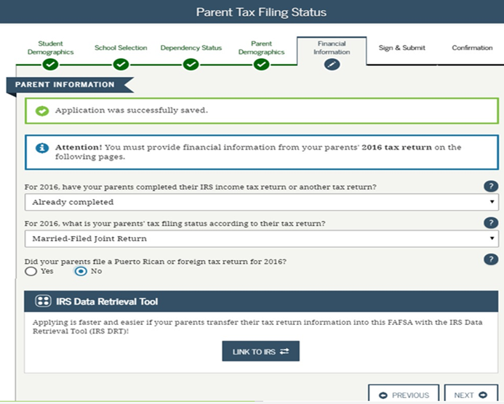
IRS Data Retrieval
Notes:
FSA and the IRS developed a collaborative solution that simplifies FAFSA completion. The process allows FAFSA on the Web applicants to request and retrieve their income tax data from the IRS. The 2021-22 FAFSA will not show any data in the lines that are transferred from the IRS. The line will have a statement indicating “data transferred from the IRS.”
Idea is that more applications will have more accurate data, which will contribute to increased accuracy in awarding financial aid. (note the year is incorrect in the slide)

Slide 16
CONFIRMATION PAGE
Notes:
Once you submit the FAFPSA, you will receive a conformation page. Point out DRN #, can give to institutions not listed on FAFSA to add their school.

Slide 17
CONFIRMATION PAGE
Notes:
Point Pell eligibility and direct student loan only federal programs also mention if you have two in college you can transfer information to the next student.

Slide 18
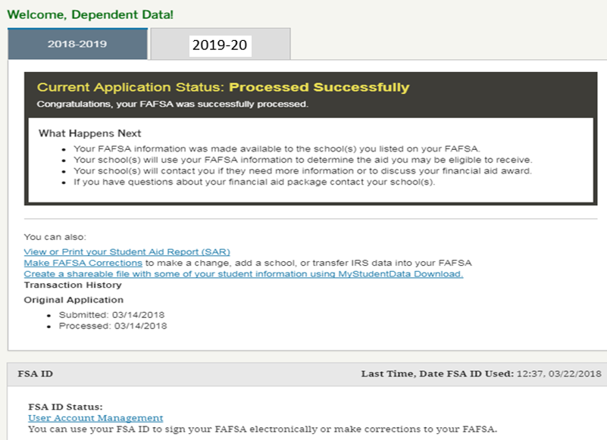
STUDENT AID REPORT (SAR)
Notes:
Point out EFC. Can access your Student Aid Award (SAR). You may need to provide a copy of the SAR for additional grant and scholarship applications. You may also get picked for a process called verification. If this is the case, the college financial aid office will be in contact with you.

Slide 19
Verification Process
This is a process your college uses to confirm that the data reported on your FAFSA form is accurate.
Don’t assume you’re being accused of doing anything wrong.
Students are selected for verification at random; and some schools verify all students' FAFSA forms.
If selected, provide the documentation your school asks for—and be sure to do so by the school’s deadline so you don’t jeopardize your financial aid.
Your college may request an IRS Transcript or a copy of your federal tax return.
Notes:
Families may get selected for the Verification Process. Families are selected randomly for this process and the college will notify the student about the additional documents that are needed to complete this process.
.

Slide 20
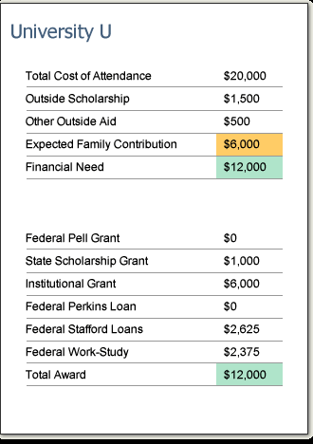
FINANCIAL AID AWARD NOTICE
The College Financial Aid Office issues a FINANCIAL AID AWARD
Consisting of:
The Cost of Attendance
Expected Family Contribution (EFC)
Your financial aid eligibility
A description of each program
!
Notes:
Once your file is complete in the college financial aid office, a financial aid award will be issued for any of the postsecondary institutions where you have been accepted and you listed on the FAFSA. This is usually posted on your student account or sent to you via email. Watch your student account at the schools where you have been accepted and check the email address you provided. For more information on what comes next -please reference the next steps handout in the student folder provided. REMEMBER THAT YOU NEED TO REAPPLY FOR FINANCIAL AID EVERY YEAR BY COMPLETING THE FAFSA RENEWAL.
Remind families that all schools evaluate the student differently, therefore it’s likely awards will vary.

Slide 21
Special Circumstances? Contact the Financial Aid Office
Divorce/Separation
Loss of income or benefits
One-time income
Death or Disability of student or parent
Medical/Dental expenses not covered by insurance
Elementary or secondary school tuition
Dependency override
(Note: Professional Judgment is at the sole discretion of each institution
and you must contact each college financial aid to make a request.)
Notes:
Also briefly explain what special circumstances can be considered by aid offices: divorce/separation, loss of income or benefits, one time income, substantial paid medical/dental bills. Reiterate that they should talk directly to the aid office at the school they plan to attend for direction on to proceed if they have a special circumstance.

Slide 22
You could win a scholarship!
Please be sure to complete the *online evaluation and *scholarship application in the computer lab upon completion of your FAFSA
$15,000 in College Goal Wisconsin Scholarships are being given away!
Names will be randomly drawn and scholarship winners will be notified.
Notes:
By attending College Goal Wisconsin today you will be eligible to enter the scholarship drawing. $15,000 will be awarded to attendees of the 2020 College Goal Wisconsin event. To apply for these scholarships you must complete an online survey in the computer lab. Upon completion of the survey, a CGWI volunteer will provide you with a scholarship entry form. Make sure you turn this in before you leave today. You will be notified if your name is drawn for a scholarship. A list of scholarship recipients will be posted on the CGWI website as well.

Slide 23
THANK YOU TO OUR College Goal Wisconsin Partners
Notes:
– Funding for the scholarship as well as today’s event has been provided by
Ascendium, Sentry, Walmart, EPIC,
Co Vantage Credit Union
UW Credit Union
Wisconsin Association of Financial Aid Administrators
University of Wisconsin System
Wisconsin Association of Independent College and Universities
Wisconsin Technical Colleges

Slide 24
Thank you
for attending
College Goal Wisconsin
2021!
Notes:
Thank them for attending
Ask for questions
Provide question and answer for about 10 minutes maximum
Provide site specific directions instructing them how the remainder of the day will proceed.

